Slide 1

What makes a project exciting?
Data Analyst Chalenge
Name: Cesar Roma Filho

Slide 2
Overview
The challenge consists of identifying what makes a project exciting and it is based on Kaggle competition from Donorschoose.org.
To answer this question the competition has 4 datasets from more than 664 thousand projects from 2012 till 2014.
The datasets contain 83 fields related to the projects with information from the schools, donations, socio-geographic, etc.
To be considered exciting the project must meet 5 criteria, these criteria and the label with projects already considered exciting are in the data set outcome.csv.
For the clean, analysis and data visualization of the data it was used mainly python.

Slide 3
Exploratory Data Analysis- Outcomes
Requirements for project be exciting
5 requirements:
Fully donated
1 teacher referred donor
Higher than average percentage of donors leaving an original message (great chat)
At least one green donation (donation made with credit card, PayPal, Amazon or check)
Has one or more of:
donations from three or more non teacher-acquired donors
one non teacher-acquired donor gave more than $100
the project received a donation from a "thoughtful donor"
Some projects from 2014 were still running when the challenge was released, so most of the analysis will be used projects with date before 2014
On the outcomes data set we have ~619 thousand projects.
~36 thousand projects considered exciting which is ~6% of the total.

Slide 4
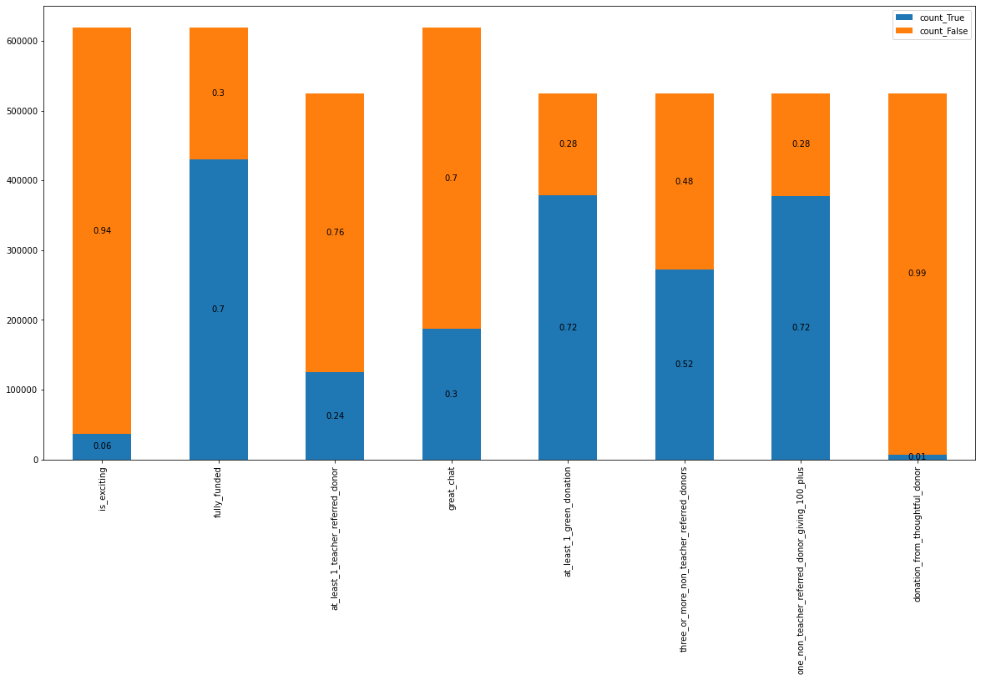
Exploratory Data Analysis- Outcomes
Requirements Count
Requirements vs Exciting
fully_funded | 1_teacher_referred_donor | great_chat | 1_green_donation | Not_excting | Exciting
f | f | f | f | 26,305 | 0
f | f | f | t | 14,343 | 0
f | f | t | f | 17,311 | 0
f | f | t | t | 21,085 | 0
f | t | f | f | 1,184 | 0
f | t | f | t | 6,215 | 0
f | t | t | f | 932 | 0
f | t | t | t | 7,281 | 0
t | f | f | f | 84,610 | 0
t | f | f | t | 137,641 | 0
t | f | t | f | 11,939 | 0
t | f | t | t | 87,034 | 0
t | t | f | f | 3,041 | 0
t | t | f | t | 64,441 | 0
t | t | t | f | 913 | 0
t | t | t | t | 3,943 | 36,710
Considered as 1 requirement
For the contingency table were drop the rows with null values.
We have ~ 87 thousand projects( %17 of the total) when all the requirements are True but not the teacher reference.
When just “Great Chat” is false we have 64 thousand projects (13% of total)

Slide 5
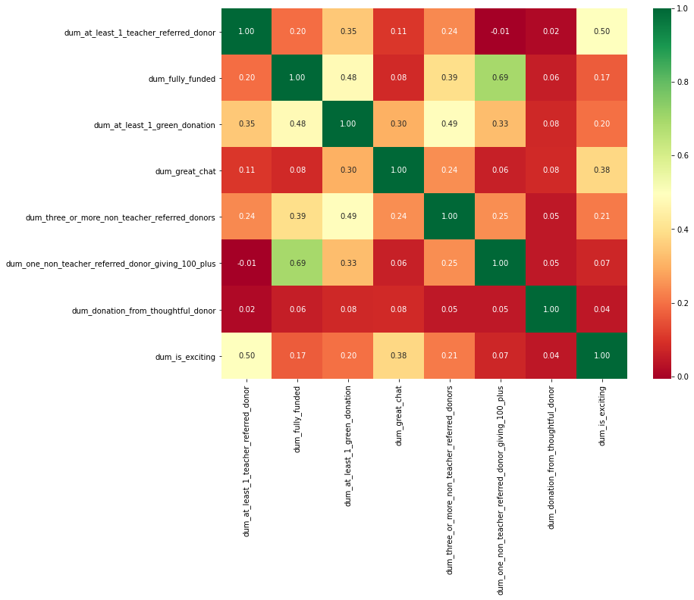
-To perform correlation the requirements were transformed into dummy variables (false=0, true=1). - The requirement , if a donor came by a link from a teacher has the highest correlation ~0.5 with the classifier (is_exciting) -The importance of the teacher influencing donors could be a key requirement
Exploratory Data Analysis- Outcomes
Correlations

Slide 6
-This test is better to perform associations between categorical variables.(High values for Chi and pval shows association). - Cramer’ V test shows how big is this association (the higher the Cramer value the greater the association). -The importance of the teacher influencing donors could be a key requirement for the classifier.
Exploratory Data Analysis- χ² test Outcomes
Chi square test
Variable | chi2 | pval | dof | critical value for Chi | flg_critical | flg_pval | cramer_test
at_least_1_teacher_referred_donor | 126729.8 | 0 | 1 | 10.83 | TRUE | TRUE | 0.66
fully_funded | 17090.92 | 0 | 1 | 10.83 | TRUE | TRUE | 0.24
at_least_1_green_donation | 15240.24 | 0 | 1 | 10.83 | TRUE | TRUE | 0.23
great_chat | 90096.65 | 0 | 1 | 10.83 | TRUE | TRUE | 0.56
three_or_more_non_teacher_referred_donors | 18659.2 | 0 | 1 | 10.83 | TRUE | TRUE | 0.25
one_non_teacher_referred_donor_giving_100_plus | 235.31 | 0 | 1 | 10.83 | TRUE | TRUE | 0.03

Slide 7
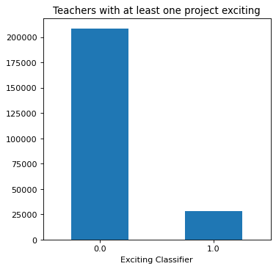
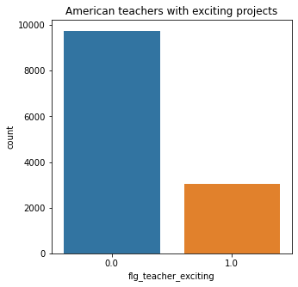
Exploratory Data Analysis- Teachers
On the dataset was created a binary variable if the school has at least one exciting project (flg_teacher_exciting)
Exciting projects are highly concentrated in 11% of the teachers.
40 k
55 k
10 k
Teachers who are classified as exciting has on average ~6 projects released compared to the global average as 3.
15 k
3 k
The most correlated feature with flg_teacher exciting was if the teacher teaches for America, accordingly with cramer’s v test.
23% of the American teachers have an exciting project.
15 k
15 k
28 k

Slide 8
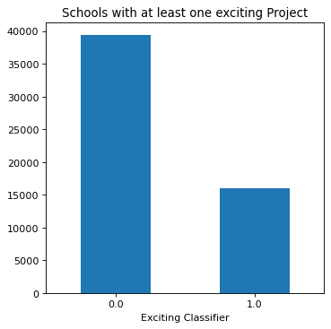
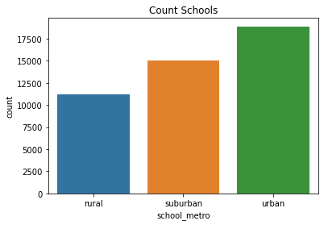
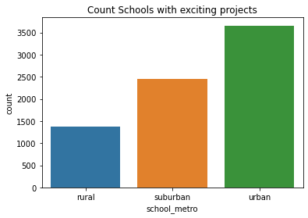
Exploratory Data Analysis- Schools
On the dataset was created a binary variable if the school has at least one exciting project (flg_school_exciting)
Exciting projects are concentrated in 30% of the schools.
The most correlated category with the school_excting is school_metro(if the school is situated in a metropolitan area), accordingly with Cramer’s V test.
40 k
15 k
35%
55%
35%
30%
55 k
29%
15%
40 k
15 k
15 k

Slide 9
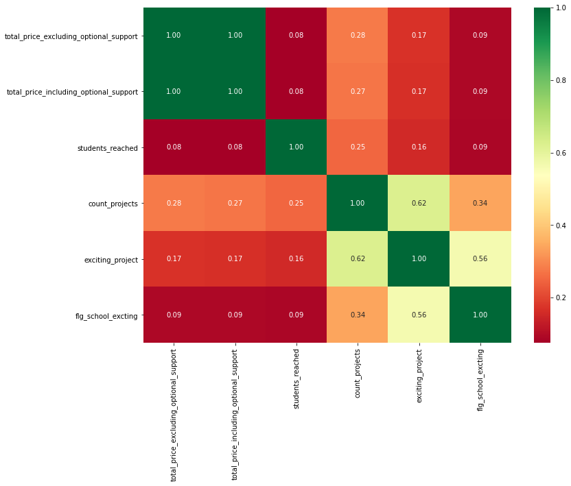
For continuous variables, just the correlation between number of projects per school and number of exciting projects per school are high correlated.
Exploratory Data Analysis- Schools
Correlations

Slide 10
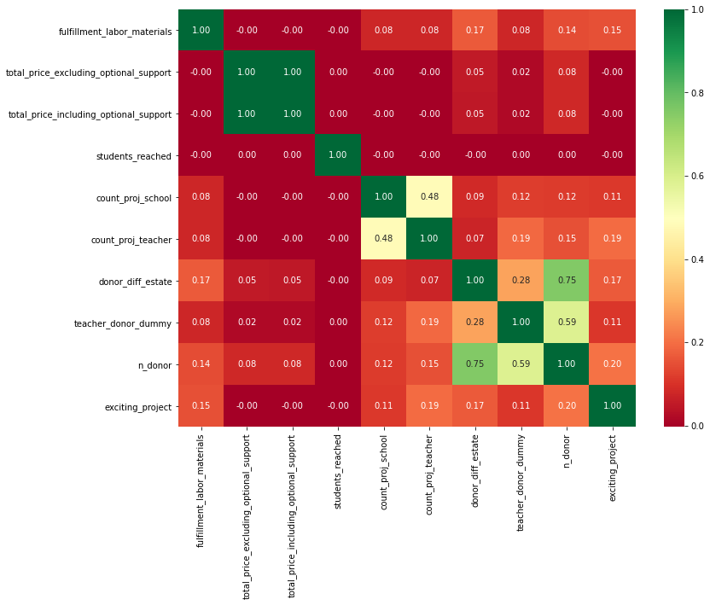
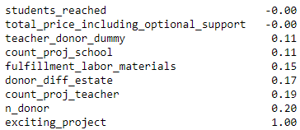
Exploratory Data Analysis- Projects
was created 2 new variables for the dataset related to donor:
S, n_donor (the number of donors per project
Donors_diff_state (the number of donors from different state of the project)
Count_project_teacher (number of exciting projects by teacher)
Count_project_school (number of exciting projects by school)
Message_len: Sum of messages length.
40 k
15 k
Most correlated features by exciting projects
55 k
40 k
15 k
15 k

Slide 11
The most correlated feature for projects is if the teacher already have a project classified as exciting or not. The other categories are correlated accordingly with the chi square, but the correlation are very small accordingly with Crame’s test
Exploratory Data Analysis- Projects
Categorical analysis Cramer’s test
Var | chi2 | pval | dof | critical value | flg_critical | flg_pval | cramer_test
primary_focus_subject | 519.12 | 0 | 26 | 38.89 | TRUE | TRUE | 0.01
primary_focus_area | 348.57 | 0 | 6 | 12.59 | TRUE | TRUE | 0.01
secondary_focus_subject | 393.84 | 0 | 26 | 38.89 | TRUE | TRUE | 0.01
secondary_focus_area | 85.53 | 0 | 6 | 12.59 | TRUE | TRUE | 0.01
resource_type | 382.35 | 0 | 5 | 11.07 | TRUE | TRUE | 0.02
eligible_almost_home_match | 12.83 | 0 | 1 | 3.84 | TRUE | TRUE | 0.01
grade_level | 63.03 | 0 | 3 | 7.81 | TRUE | TRUE | 0.01
eligible_double_your_impact_match | 31.9 | 0 | 1 | 3.84 | TRUE | TRUE | 0.01
flg_school_exciting | 22120.29 | 0 | 1 | 3.84 | TRUE | TRUE | 0.28
flg_teacher_exciting | 117914.8 | 0 | 1 | 3.84 | TRUE | TRUE | 0.64
55 k
40 k
15 k
15 k

Slide 12
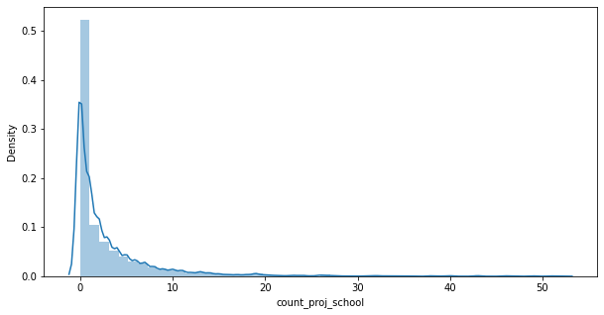
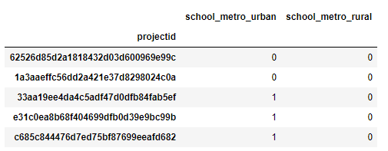
Preprocessing Data for Classification models
Selected features
count_proj_teacher: number of teachers exciting projects (Numeric) count_proj_school: number of schools exciting projects (Numeric) donor_diff_estate: Donors number of the project from different state (Numeric) n_donor: Donors number of the project (Numeric) message_len: The total length of all messages (Numeric) school_metro: School metropolitan area (Text: Urban, Suburban, Rural) poverty_level: school's poverty level (Text: Low, Moderate, High) teacher_teach_for_America: If the teacher teaches for America
Numeric features
Outliers: Were considered outliers all numbers which were 2 times higher than the standard deviation plus median. Replace these numbers by the median Scaling | Standardization : Scale of the values of the features so that the mean = 0 and standard deviation =1. NULL values: Rows with at least one null value were drop from the model dataset.
Text features
Dummy Variables: Were created new variables representing in a binary way (0,1). One of the new columns were dropped to avoid Multicollinearity.
count_proj_teacher distribution

Slide 13
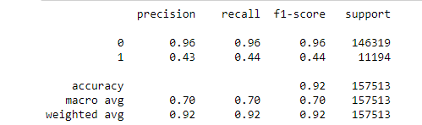
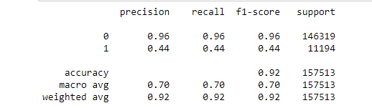
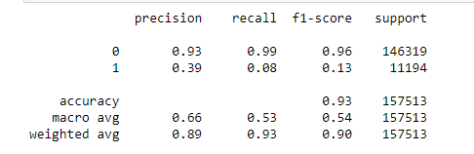
Classification Models
Decision Tree
Classification models
Three classification models were chosen:
Decision Tree
k-nearest neighbors (metric = Euclidean)
Logistic Regression
The clean dataset has 525.042 rows.
For the model was selected, randomly, 30% of the dataset.
KNN
Logistic regression

Slide 14
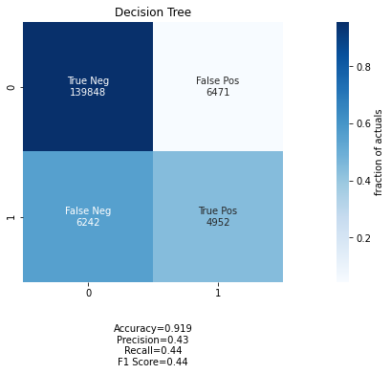

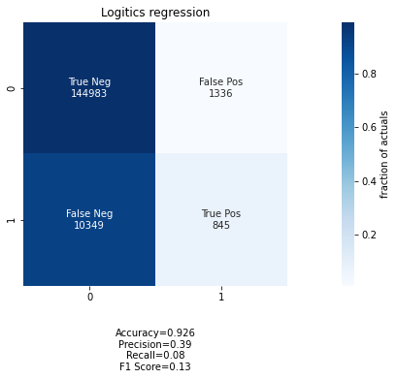
Classification Models
Classification models
The aim of the classifier is to classify if a project is exciting.
Recall and precision are the eliminatory tests in this case.
40 k

Slide 15
KPIs Suggested
Number of exciting projects/ total Number of projects.
Projects carried out by teachers with a successful track record.
School projects with a successful track record.
Number of donors per project, local and from another estate.
Number of messages by project.
The length of the messages by project.
Projects from schools from a high-income area.
Projects from schools in urban areas.
Track projects classified as potentially exciting by KNN alghorithm
55 k
40 k
15 k

Slide 16
Further analysis
Create dashboard in Power BI to track all the KPIs.
Try the model with different parameters (try to find the best number for K in KNN model).
Try different models as Gradient Boost.
Reduction metrics techniques as Principal Component Analyses.
RandomOverSampler: Randomly duplicates a point from the minority class, to balance the numbers of exciting projects in the samples.
Classify schools and teachers with a cluster analysis (K-means) for new KPIs.
Use Natural Language Processing to identify trends in the comments from the donors.
55 k
40 k
15 k

Slide 17

Further analysis NLP
A logistic regression was performed to classify the projects with variables high correlated with the classifier, but the results were still inconclusive.
Try the model with different parameters or different models as random forest tree.
Classify schools and teachers with a cluster analysis (K-means).
Use Natural Language Processing to identify trends in the comments from the donors.
55 k
40 k
15 k

Slide 18


